Slide 1

Grasshopper Convertor
Kevin Aaron Herrera Claros
Eliana Angélica López Hurtado
Adrián Rojas Arévalo
Kevin CSánchez D.
AWT01 - 24/09/2018
Jalasoft Foundation

Slide 2
About me
I'll help you convert videos and audio files to the format of your choosing making media management a lot easier.
I´m an open source application which means that the code and the installer is free.
I’m excited to partner with you!

Slide 3
Easy Process
Converter options
Converted File
Search media through metadata
Easy View design
Play your media

Slide 4
VIEW DESIGN

Slide 5
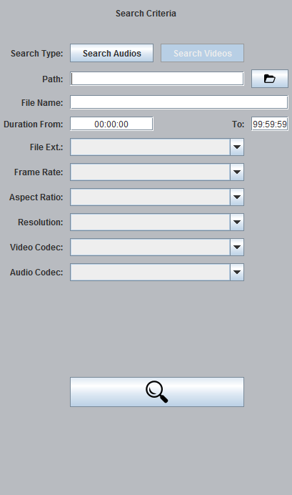
SEARCH PANEL
The search section allows you to search for multimedia files on the local environment through their metadatas.
*Current version supports audio and video files search.

Slide 6
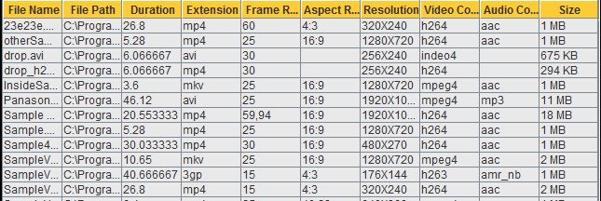

RESULT PANEL
This section shows a list of results from the search criteria entered. These files are displayed with all the metadata details specific to the media type.
Making a double click in a file of the list will play the file.

Slide 7
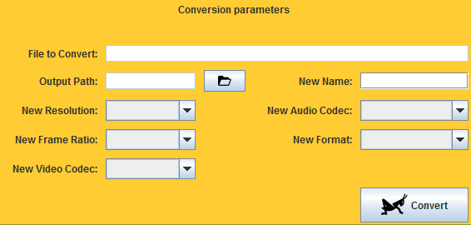
CONVERSION PANEL
The conversion section gives you the available options to do the conversion of audio files and video files.

Slide 8
Search Options

Slide 9
Options available to search video
Extension.
MP4, AVI, FLV, MKV, MOV, 3GP.
Frame Rate.
24, 25, 29, 29.7,30, 60.
Aspect Ratio.
16:9, 16:10, 0:1, 4:3, 40:23.
Resolution.
1920X1080, 1280X720, 640X480, 640X368, 480X270, 320X240, 256X240, 176X144.
Video Codec.
H264, h263, vp6f, indeo4, mpeg4, flv, avi.
Audio Codec.
Mp3, pcm_u8, wmav2, ogg, flac, aac

Slide 10
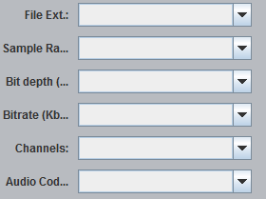
Options available to search audio
Extension.
MP3, WMA, WAV, OGG, FLAC.
Sample Rate.
11025, 22050, 44100, 48000.
Bit Depth.
U8, s16, s16p, fltp.
Bitrate.
24000, 32000, 48000, 64000, 96000, 127999, 128000, 129737, 176456, 838371.
Channels.
1, 2
Audio Codec.
Mp3, pcm_u8, wmav2, ogg, flac, aac

Slide 11
Convertor Options

Slide 12
Options available to convertor video
New Name.
Output Path.
Format.
MP4, AVI, FLV, MKV, MOV, 3GP.
Frame Rate.
24, 25, 29, 29.7,30, 60.
Aspect Ratio.
16:9, 16:10, 0:1, 4:3, 40:23.
Resolution.
1920X1080, 1280X720, 640X480, 640X368, 480X270, 320X240, 256X240, 176X144.
Video Codec.
H264, h263, vp6f, indeo4, mpeg4, flv, avi.
Audio Codec.
Mp3, pcm_u8, wmav2, ogg, flac, aac

Slide 13
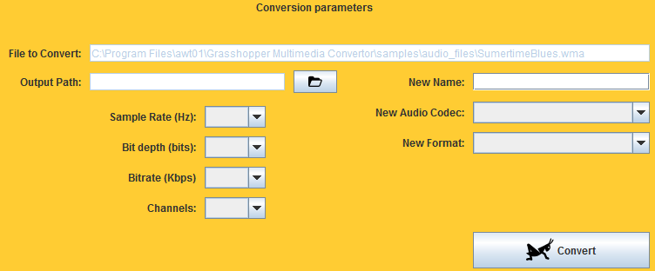
Options available to convertor audio
New Name.
Output Path.
Extension.
MP3, WMA, WAV, OGG, FLAC.
Sample Rate.
11025, 22050, 44100, 48000.
Bit Depth.
U8, s16, s16p, fltp.
Bitrate.
24000, 32000, 48000, 64000, 96000, 127999, 128000, 129737, 176456, 838371.
Channels.
1, 2
Audio Codec.
Mp3, pcm_u8, wmav2, ogg, flac, aac

Slide 14
STRUCTURE OF THE PROGRAM

Slide 15
MVC
Model
View
Controller

Slide 16
STRUCTURE OF PACKAGES

Slide 17
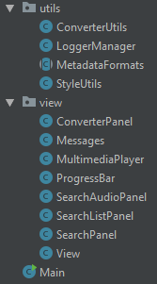
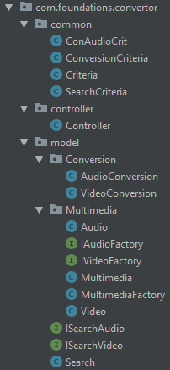
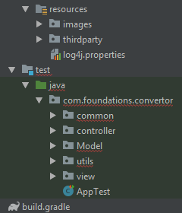
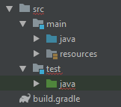
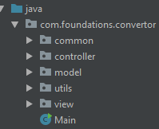
Gradle Build

Slide 18
DIAGRAM OF CLASSES

Slide 19
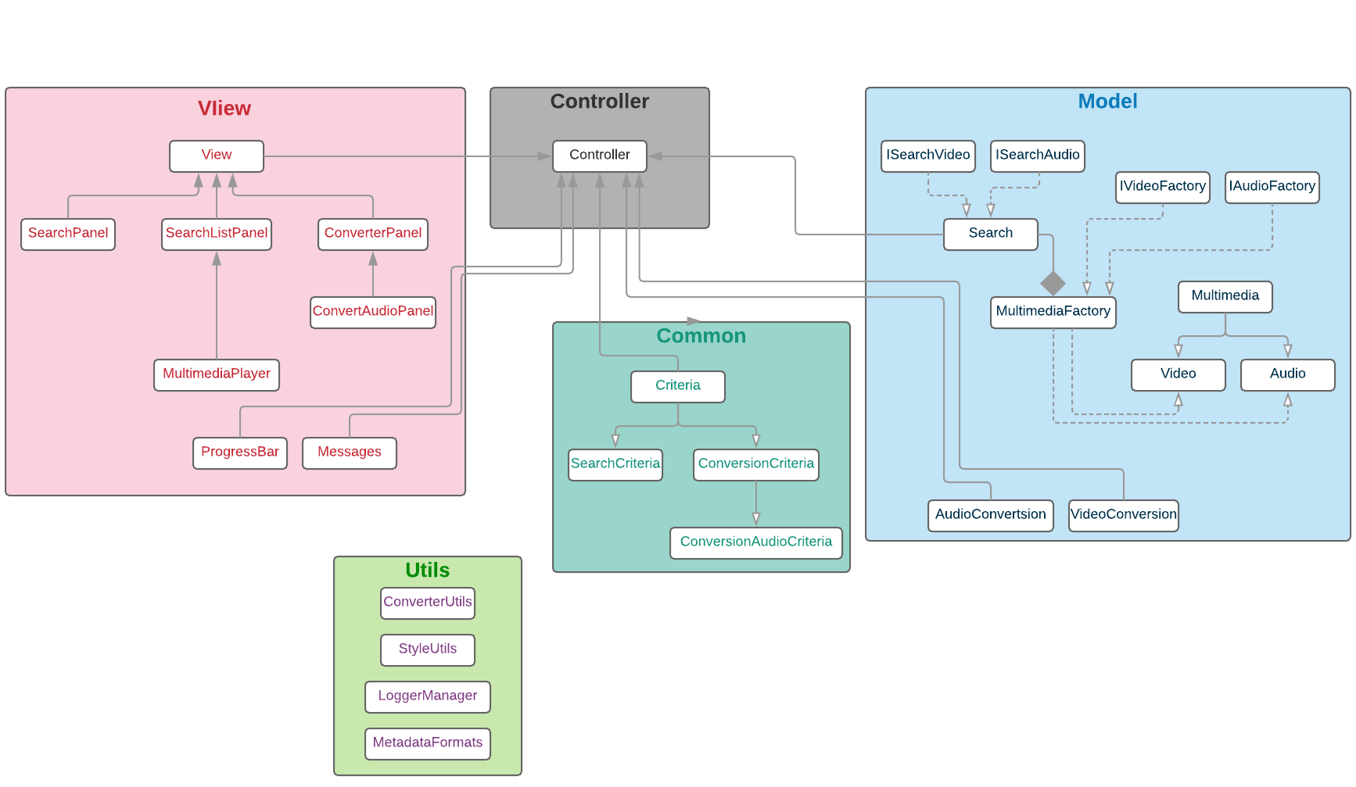

Slide 20
CODE COVERAGE

Slide 21

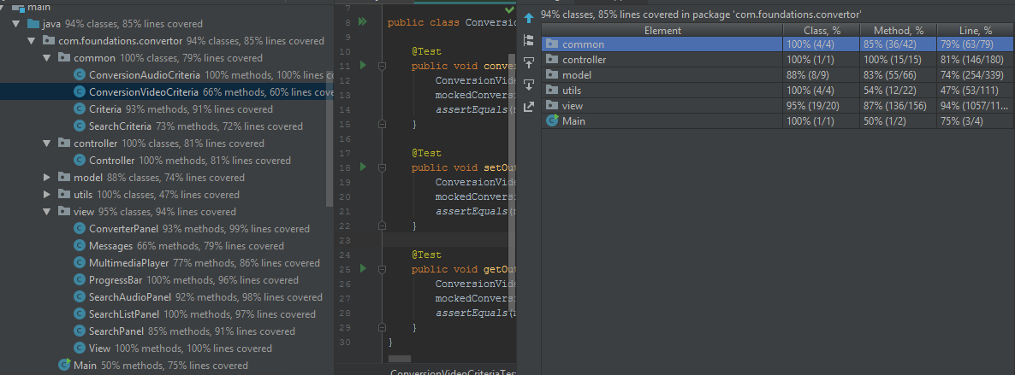
Code Coverage - IntelliJ

Slide 22
Demo

Slide 23

Contact
info@fundacion-jala.org
www.fundacion-jala.org

